Slide 1

Test Strategy Clinical Trials Supply Management (CTSM)
Created by: Holly Reese
Version: 0.7 (Draft) Updated December 08, 2020
Internal

Slide 2

Agenda
Overview & Scope
Roles at SAP
Roles at Customer
Project Plan Timelines
Test Activity Overview
Test Types in Detail
Automated Testing
Product Standards
Sprint Testing
Internal Integration Test
Customer Acceptance Test
Test Systems and Test Data
Test Reporting
Reference

Slide 3
Sprint Useful Information

Slide 4
Sprint Cycle
Modified by Chunyang
Dev Start
Soft Dev Close
Dev Start
Soft Dev Close
week 5 / 1
week 2
week 3
week 4
week 5 / 1
week 2
week 3
week 4
week 5 / 1
Start Sprint X
Start Sprint X+1
Start Sprint X+2
Dev Team
Real development duration
Real development duration
Sprint x: Development @ Dev environment
Quality tasks*
Sprint x+1: Development @ Dev environment
Quality tasks*
Sprint x+2 Dev…
Architects
Transport / deploy to Q env.
Transport / deploy to Q env.
Tenthpin / SAP
Tenthpin review cust. test cases Sprint x
SAP / Tenthpin writes additional test cases
SAP / Tenthpin internal informal and internal Sprint tests Sprint x
Tenthpin review cust. test cases Sprint x+1
SAP / Tenthpin writes additional test cases
SAP / Tenthpin internal informal and internal Sprint tests Sprint +1
QMs
Zephyr setup
Zephyr setup
Customer
Customer prepares test cases & data for Sprint x
Customer prepares test cases & data for Sprint x+1
Customer tests of Sprint x
POs / Architects
POs / Architects evaluate and prioritize new bugs and feedback at least weekly. Very high / high Bugs added to current Sprint, solved, and sent to Q directly. High / medium priority Bugs added to next/future Sprint.
POs / Architects evaluate and prioritize new bugs and feedback at least weekly. Very high / high Bugs added to current Sprint, solved, and sent to Q directly. High / medium priority Bugs added to next/future Sprint.
POs …
External & internal backlog refinements, based on feedback for Sprint x or later
External & internal backlog refinements, based on feedback for Sprint x+1 or later
*Quality tasks for Developers:
Informal testing
Automated test preparation
Code/peer reviews
Bug fixing

Slide 5
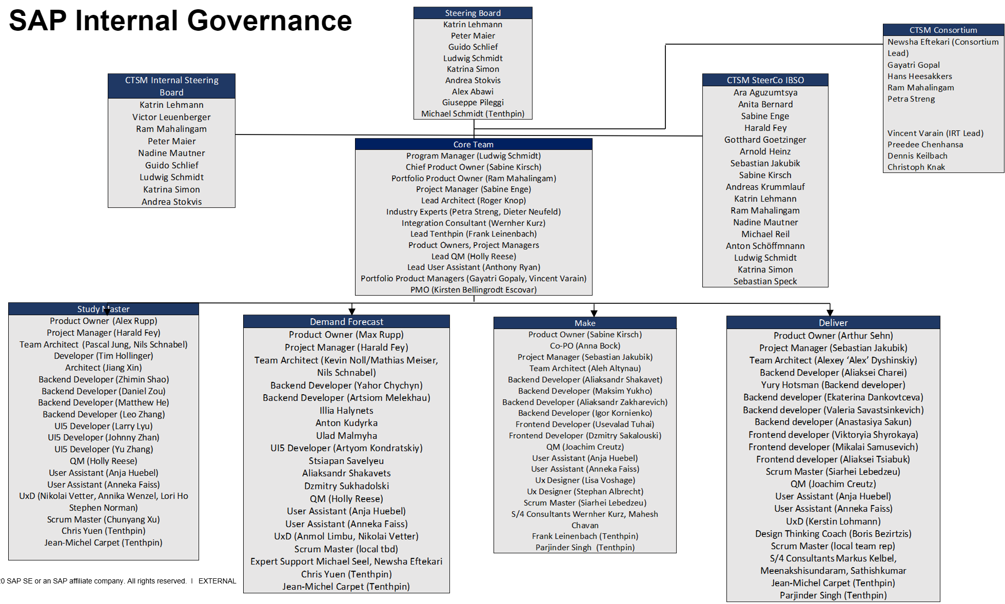
Org

Slide 6
Internal Burndown Chart
\\cnpvgl000.pvgl.sap.corp\restricted\CD\Projects\SCM_Projects\CTSM\1.SM_Sprints\Sprint6\BurnDownChart-xcy.xlsm

Slide 7
Modified by Chunyang
Status lifecycle in Jira within a Sprint test
In a Test Cycle
STORY
TEST CASE
TEST EXECUTION
BUG
Create Story
Open
Open
Unexecuted
Open
Add Story to Sprint
Create Test Case
Review Test case
Create Test Execution
Execute Test
Create Bug(s)
Review & Prioritize
By Architect
Ready for Dev
Ready for Dev
Pass
Fail / Blocked
Ready for Dev
Obsolete
Assign to developer
Retest
Assign to developer
Bug is fixed and can be retested by revising the previous Test Execution
In Progress
In Progress
Develop Code
Fix Bug
In Review
In Review
Review the code
Review the code
Completed
Completed
Note: The „faded out“ steps and processes are indirectly relevant to testing and are for information only.

Slide 8
Done Criteria
Modified by Chunyang
Latest version here: https://confluence-ibs.wbs.net.sap/display/CTSM/Definition+of+Done
The Definition of Done (DoD) for all developments are as follows:
Needed for In Review: Coding created, including acceptance criteria met, and coding documented (inline)
Needed for In Review: Critical issues from static check tools solved / required exemptions approved
Needed for In Review: Test case(s) written for SAP internal tests (where applicable)
Needed for In Review: Code tested (developer tests in Dev, undocumented) and critical issues fixed
Needed for In Review: Test automation created (where applicable), automatic unit test passed and no existing unit tests broken
Needed for In Review: Raw documentation in system or dedicated place
Needed for In Review: Go through Code Review checklist
Needed for Completed: Code Review requirements confirmed by a second person (Architect)
Needed for Completed: Code merged into main branch and deployed to test system
The criteria labeled "Needed for In Review" are to be done by the developers. The criteria labeled "Needed for Completed" are to be done by the reviewer (Architect)

Slide 9
Tools Reference
For More Detailed List
Modified by Chunyang
Category of Tools | Tools for Non-ABAP | ABAP
Source Code Repository with Version Management | GIT, SVN, Clearcase, ABAP | ABAP Workbench
Code / Release building | Maven, Ant | ABAP Workbench
Continuous Integration | Jenkins, CoDePipes, Bamboo | ABAP Workbench
Static Code Check | FindBugs, SourceMonitor, PMD, ESLint, JSLint | Code Inspector
Security Code Check | Fortify, CheckMarx | ATC
Coding Style | CheckStyle | NA
Integrated Development Environment | Eclipse, NetBeans, VScode | ABAP inbuilt Editor, Eclipse
API Documentation | JavaDoc | ABAP Documentation
Unit Test | Junit, TestNG, QUnit, Clover, Easymock, Jest | ABAP Unit
Code Review Tools | Fisheye Crucible, JIRA, Gerrit, Github | Excel, Code Collaborator
Reporting & Coverage Measurement Tools | SonarQube (previously Sonar) | SCOV
Automation Test Tools | Selenium WebDriver, UFT, UIveri5 | eCATT, UFT
Performance Test Tools | Jmeter, LoadRunner | STAD, ST05, SAT, ST12, ST03n
Defect Management Tool | JIRA, Github Issues, Bugzilla | CSS
Test Repository Tool | HP QC, Excel | GTP
Documentation Tool | Confluence, Wiki, JAM | Wiki, JAM
Project Management – Scrum / D³ | VersionOne, JIRA | VersionOne, JIRA

Slide 10
Product Details

Slide 11
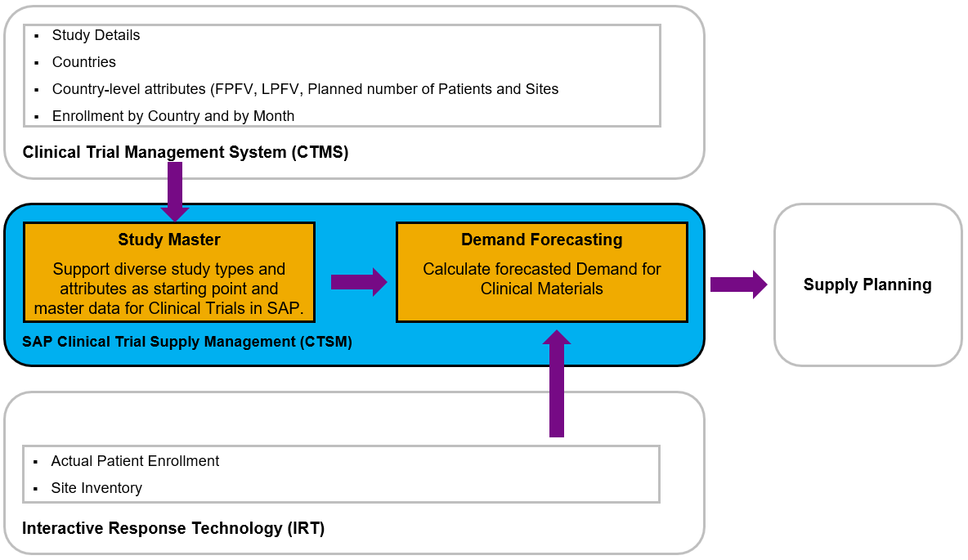
CTSM Data Flow & Integration with CTMS and IRT
Notes:
First, let’s understand the role in a purist agile world

Slide 12
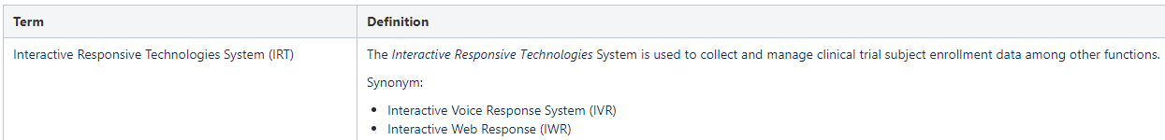
Terminologies
IRT Integration (Actual Enrollment)

Slide 13
Overview & Scope
Timelines, Roles, Methodology, Test Activities

Slide 14
Roles and Responsibilities at SAP
Product Owner
responsible for the value delivery of the solution
aligns with the customer representative of the end users and the LOB
captures requirements of the customer and target users in the product backlog
estimates efforts, supported by other team members
ensures vision and requirements are understood by the development team
accepts or rejects work results of sprints
makes final decision for tough solution decisions
Scrum Master
is a servant leader
is responsible for the scrum process
empowers and protects the team
is coach and facilitator for the development team and the product owner
is responsible to address and remove impediments
is responsible to improve scrum process (velocity)
has veto power against product owner and other stakeholders if scrum rules would be broken or the team is strongly affected
Project Manager /Program manager
manages communication to and alignment of project stakeholders
aligns with customer project manager for budgets and timelines
responsible for cost management (budget & controlling) of the project
manages project risks
ensures staffing, and compliance to regulations
organizes customer and team interactions such as milestone reviews
Architect
defines the overall technical solution architecture (incl. determination of UI technologies)
makes high-level software design decisions and aligns with customer
manages architecture alignment in the large scrum of scrum settings
leads the development team with technical expertise
supports product owner creating effort estimates
coaches and reviews the work of junior developers
Notes:
First, let’s understand the role in a purist agile world

Slide 15
Roles And Responsibilities at SAP – Cont’d
Quality Mgr. / Tester
coordinates the quality assurance activities for the solution
plans testing, code reviews, and standards compliance
tracks and reports quality status
executes repetitive tests in sprints
designs and runs automated tests in sprints
often tests integration aspects of the features
Information Developer
defines the User Assistance concept in collaboration with development
collaborates with UX to review mockups, ensuring usability and clarity of all UI texts
researches and creates terms and glossary definitions, ensuring consistency of terminology
ensures the creation of high-quality, intuitive UI texts
creates all in-scope end-user documentation
creates all in-scope documentation targeted at the implementation team, system administrators, and power users (for example, Admin Guides, Customizing documentation, Solution Manager content)
coordinates translation with the SLS translation team
assists in testing as needed
Developer
self-organizes to accomplish milestone work
develops solution code and test cases
can specialize in user interface, middleware, or backend development
reports progress and impediments in daily sprint meetings
UX Designer
plans, presents, conducts and analyzes user research and validations
drives design iterations with the customer to achieve sign-off in time
supports the product owner in requirements definition
delivers interaction design and visual design
reviews user interface implementation during development
estimates effort for UX design activities

Slide 16
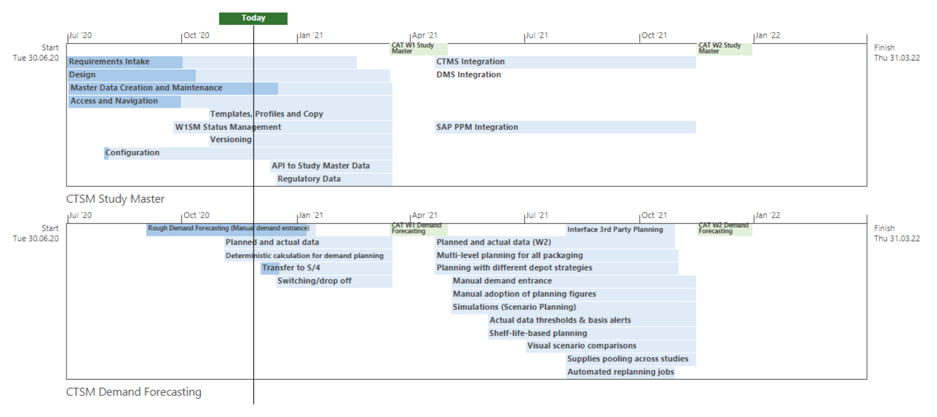
Project plan timeline for Study Master and Demand Forecast streams

Slide 17
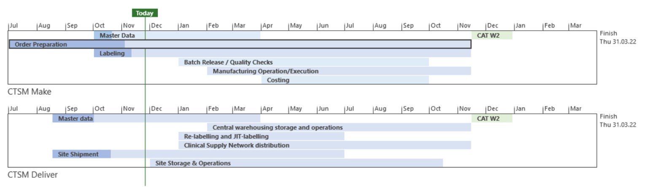
Project plan timeline for Make and Deliver streams

Slide 18
Roles and Responsibilities at Customer
Role | Responsibility with regards to Test Activities
Project Lead Customer | Primary contact between the test group and SAP Primary contact for all change control requests (if any)
Test coordinator Customer | Primary contact for all testing activities Responsible for coordinating the test activities, resources and reports at Customer
Subject Matter Experts | Create test cases that validate listed functions on the Specification, based on Customers’ business process scenarios. Data customization tasks for the development / test systems. Creates and input configuration, master data, transactional data and pre-staged test data.
Tester | Executes the test cases and provide test feedback in accordance with the agreed tools. Submits detailed information regarding issues and defects Verifies defects that have been fixed
System administrator | Responsible for availability of the development and test systems

Slide 19
Test activities – overview of internal test activities by developers
Test Activities | Frequency | Testers | Systems | Goal
Internal Informal Tests | In Each Sprint, validating development Use acceptance criteria, log bugs in GitHub or Jira (Cloud) | Developers | Dev tenant, X38 | Test functionality
Product Owner / Architect Tests (against acceptance criteria) | In Each Sprint, during review | POs, Architects | Dev tenant, X38 | Validate functionality, prepare for customer demo
Automated tests Unit tests, static code checks, security checks, UI checks | In Each Sprint (also run at deployment) | Automatic | Respective pipelines, respective S/4 systems | Ensure code quality
Functional Test Automation | During project | Automatic | Cloud live Test tenant, Z38 | Execute functional scenarios repeatedly

Slide 20
Test activities – overview of product standards related test activities
Test Activities | Frequency | Testers | Systems | Goal
Threat Modeling | Scheduled: January 2021 | External testing team, Architects, QM/PM optional | Cloud live Test tenant, Z38 | Verification of security mechanisms
Performance test | During project | Architect (QMs possible) | Cloud live Test tenant, Z38 | Verification of responsiveness and stability
Penetration Test | Near end of each wave | External testing team, Architects, QMs | Cloud live Test tenant, Z38 | Security verification
Accessibility Test | Near the end of Wave 2 | External testing team, Architects, QMs | Cloud live Test tenant, Z38 | Verify that we meet accessibility requirements
UX Test | Near end of each wave | UXs and UAs | Cloud live Test tenant, Z38 | “Glamor test” to ensure the UIs are all correct

Slide 21
Test activities – overview of Sprint/CAT related test activities
Test Activities | Frequency | Testers | Systems | Goal
Internal SAP Sprint Tests | During Each Sprint (Use test cases for Sprint test and later CAT, log bugs in Jira) | Tenthpin (QMs or other testers possible) | Zephyr, (Dev tenant, X38) & Cloud live Test tenant, Z38 | Document functionality, declare readiness for next test phase / delivery
Customer Sprint Tests | After Each Sprint (Use test cases for Sprint test and later CAT, log bugs in Jira) | Customer | Zephyr, Cloud live Test tenant, Z38 | Declare readiness for next test phase / delivery, gain customer feedback
SAP Internal Integration Test | After development close, before CAT | Development team (SAP side) | Cloud live Test tenant, Z38 | Verify cross functional integration of program modules
Customer Acceptance Test (CAT) | After Internal Integration Test | Customer, POs, Architects, QMs | Cloud live Test tenant, Z38 | Customer validation

Slide 22
Test Types - Details

Slide 23
Automated Code Quality & Test Management Tools
Tool | Tool | Purpose | Tool Details | Additional Information
Test Management | Jira Zephyr | Test Management Tool for Internal Integration Test and CAT | • Project name: Clinical Trials Supply Management (CTSM) • Releases: CAE Wave 1, CAE Wave 2, IDP Wave 2 • Cycles: Respective cycle per Sprint, internal and customer, Also respective cycles for Internal Integration test and Customer Acceptance Test.
Code Quality (ABAP) | CI | Code Inspector – Static Checks for ABAP | Variant Name: <Variant Name>
 | ATC | Security Checks for ABAP | Variant Name: <Variant Name> ATC Configuration Name: <..>
Code Quality (Cloud) | ESLint; SonarQube | Static Code scans for JavaScript | Automatically run in the pipeline
Security Code Scan | Checkmarx | Security Checks for Non-ABAP especially Java Script, UI5 | Automatically run in the pipeline
 | Sonar Q-Gate | Security Checks for Non-ABAP | Automatically run in the pipeline
User Interface | UIVeri5 | Checks the user interface | Automatically run in the pipeline

Slide 24
Functional Test Automation – For Discussion
Purpose of this test is to Automate & Execute the functional scenarios using a suitable Automation tool. This would be best fit for the Stable Scenarios which has several Regression Cycles planned.
INCOMPLETE
Object under Test | Stable Functional Scenarios that are part of the Regression Cycle
Assessment of Automation approach | Requirements that needs to be automated: Functional/ Non-Functional, UI/ Backend Technology to be automated: SAP GUI/ Webdynpro/ UI5 Type of Development: Demand/ On Premise/ On Mobile
Procedure | Plan the scope for Automation and initiate the process for the scenarios to be automated. The scope considered should be Stable scenarios which has very minimal UI changes. Evaluate the ROI of the Automation effort with the Project team Involve the Automation Central Team for evaluation - DL_IBSO_QM_AUTOMATION_SUPPORT Enable KT for the scenarios Once scripts created, get the handover from the Automation team Re-executions to be taken up within the team
Exit criteria | 100% completion of the Planned scope Demo acceptance of the scenarios with the required validations from the Project team Successful re-execution of the scripts within the team
Tool | Depends on UI Technologies used in Application
Notes:
E need to have test automation for GxP.

Slide 25

Functional Test Automation – For Discussion
Purpose of this test is to Automate & Execute the functional scenarios using a suitable Automation tool. This would be best fit for the Stable Scenarios which has several Regression Cycles planned.
Object under Test | <Stable Functional Scenarios that are part of the Regression Cycle> <1. Product Backlog Name – Functional Scenarios with minimal UI changes> Or <End-to-end scenarios which are complete>
Automation approach | Requirements type: <E.g. Functional/ Non-Functional, UI/ Backend> Technology to be automated: <E.g. SAP GUI/ Webdynpro/ UI5> Type of Development: <Demand/ On Premise/ On Mobile>
System | <ABC/100><…>
Tool | <eCATT/ UFT/ Selenium>
Tester | <Tester/ Developer who will be able to provide the KTs for the Scenarios planned>
Automation Team Contact | <Automation team Engineer, responsible for the Automation service>
Timeframe/ Frequency of Executions | <Delivery cycle of the Automated Scripts as Handover/ Support plan for the Executions> <Re - Executions to be done - Once in Sprint/ Once in Day / During Integration / …>
Exit criteria | 100% completion of the Planned scope Demo acceptance of the scenarios with the required validations from the Project team Successful re-execution of the scripts within the team
INCOMPLETE

Slide 26
Product Standard Tests – Documented in Sirius for each delivery
Product Standard | Purpose | When | Test Design Process
Accessibility | Verification of Accessibility quality attribute as per the defined scope of the solution. | In Sprints At the earliest after screens become ‘Testable’ Formal testing can be requested towards the last Sprint | Project Specific Checklist / Test Case / Tool Based
Business Solution Configuration | Verification of BSC Customizing for product IMG (mandatory: delta IMG, upgrade IMG). | In Sprints when the last IMG activity has been delivered. | Manual Testing By Experts
Functional Correctness | Verification that the functionality operates as expected. | Throughout project. | Documented in Sprint tests, manual testing
Globalization | Verification of Product Standard Globalization (testable requirements), including internationalization with separate Technical Language Testing (TLT), Localization , and Translation with Language Acceptance Test (LAT) | Developed throughout project, usually tested towards the last Sprint. | Project Specific Checklist / Test Case / Tool Based
Integration | Verification that the development aligns with SAP integration requirements | Planned in as early as possible.

Slide 27
Product Standard Tests – Documented in Sirius for each delivery (cont’d)
Product Standard | Purpose | When | Test Design Process
Operations Support | Verification that support needs are considered. | Evaluated/planned at beginning of project.
Performance | Verification of responsiveness and stability under various workload of the solution as per the scope defined in Planning Phase/Sprint 0 | In Sprints / Integration | STAD Analysis in Sprints , E2E during Integration
Security | Verification of the security mechanisms of the solution under test to ensure data protection and functionality as intended | Integration | Role Based Testing /Static Checks/Special Test Service
Software Lifecycle | Verification that the development can be maintained throughout its usage time. | Evaluated/planned at beginning of project.
UX Consistency | Verification of degree of ease of solution usage for intended users. | In Sprints At the earliest after screens become ‘Testable’ | Project Specific Checklist / Test Case / Tool Based

Slide 28
SAP Internal Sprint Test - Cloud
Purpose of this test is to ensure consistent quality standards during incremental development and document tests of functional correctness
Test object | User Stories
Entry criteria | • Customer test cases reviewed. If needed, SAP test cases written (Tenthpin, others?) • Development of user story complete • Test system properly set up – test data & configuration • Development unit tests successful • Code Review in progress or completed
Procedure | • Execute test cases in the Live landscape Test system – use SAP test cases & can also use customer test cases if available • Create Bugs in Jira or GitHub for the errors identified & re-test must be done after corrections • Update test & retest status in Jira Zephyr • Limitations / restrictions must be documented – to be taken up for resolution as an backlog item/task in subsequent sprint
Exit criteria | •80 % Test cases tested •90 % tested successfully (No Blocker, Critical Bugs. Open Bugs documented with action plan)
Testers | Tenthpin, possibly other testers/QM support
Tool | Manual test using Jira Zephyr
Test owner | SAP – Product Owner / Architects / Scrum Team / Quality Manager
Timeframe | After tests are available and Master pipeline is updated in the Test system Start: Beginning of the following Sprint End: At end of the following Sprint
Notes:
Note to be removed: Template Test Type slide

Slide 29
Customer Sprint Test - Cloud
Purpose of this test is to ensure quality and gain customer feedback
Test object | User Stories
Entry criteria | Manual test cases available and reviewed for the identified test scope • Development of User Story complete • Test system properly set up – test data & configuration • Development unit tests successful • Code Review completed • Code Quality checks completed – deviations corrected and exempted (if applicable)
Procedure | • Execute test cases in the Test system – use customer test cases • Create Bugs in Jira for the errors identified & re-test should be done after corrections • Update test & retest status in Jira Zephyr • Limitations / restrictions must be documented – to be taken up for resolution as an backlog item/task in subsequent sprint
Exit criteria | •80 % Test cases tested •90 % tested successfully (No Blocker, Critical Bugs. Open Bugs documented with action plan)
Testers | Customer
Tool | Manual test using Jira Zephyr
Test owner | Customer Test Coordinator (Mark Unter) With SAP QM support
Timeframe | At the start of each sprint, in a cycle beginning with Study Master & Demand Forecast Sprint 4. (Previous sprints’ tests during Sprint 3.) Start: First Monday after a Sprint starts, beginning with Sprint 4 End: Second Friday after the Sprint starts
Notes:
Note to be removed: Template Test Type slide

Slide 30
Sprint Testing Cycle
week 5 / 1
week 2
week 3
week 4
week 5 / 1
week 2
week 3
week 4
week 5 / 1
Start Sprint X
Start Sprint X+1
Start Sprint X+2
Dev Team
Sprint x: Development @ Dev environment
Quality tasks*
Sprint x+1: Development @ Dev environment
Quality tasks*
Sprint x+2 Dev…
Architects
Transport / deploy to Q env.
Transport / deploy to Q env.
Tenthpin / SAP
Tenthpin review cust. test cases Sprint x
SAP / Tenthpin writes additional test cases
SAP / Tenthpin internal informal and internal Sprint tests Sprint x
Tenthpin review cust. test cases Sprint x+1
SAP / Tenthpin writes additional test cases
SAP / Tenthpin internal informal and internal Sprint tests Sprint +1
QMs
Zephyr setup
Zephyr setup
Customer
Customer prepares test cases & data for Sprint x
Customer prepares test cases & data for Sprint x+1
Customer tests of Sprint x
POs / Architects
POs / Architects evaluate and prioritize new bugs and feedback at least weekly. Very high / high Bugs added to current Sprint, solved, and sent to Q directly. High / medium priority Bugs added to next/future Sprint.
POs / Architects evaluate and prioritize new bugs and feedback at least weekly. Very high / high Bugs added to current Sprint, solved, and sent to Q directly. High / medium priority Bugs added to next/future Sprint.
POs …
External & internal backlog refinements, based on feedback for Sprint x or later
External & internal backlog refinements, based on feedback for Sprint x+1 or later
*Quality tasks for Developers:
Informal testing
Automated test preparation
Code/peer reviews
Bug fixing

Slide 31
Status lifecycle in Jira within a Sprint test
In a Test Cycle
STORY
TEST CASE
TEST EXECUTION
BUG
Create Story
Open
Open
Unexecuted
Open
Add Story to Sprint
Create Test Case
Review Test case
Create Test Execution
Execute Test
Create Bug(s)
Review & Prioritize
Ready for Dev
Ready for Dev
Pass
Fail / Blocked
Ready for Dev
Obsolete
Assign to developer
Retest
Assign to developer
Bug is fixed and can be retested by revising the previous Test Execution
In Progress
In Progress
Develop Code
Fix Bug
In Review
In Review
Review the code
Review the code
Completed
Completed
Note: The „faded out“ steps and processes are indirectly relevant to testing and are for information only.

Slide 32
Internal Integration Test
Purpose of this test is to verify cross functional integration of program modules and test on end-to-end use cases validating the user requirements
Test object | End-to-End Processes
System | Q system (Cloud), consolidation system (ABAP)
Entry criteria | Sprint testing successful from last sprint No <Very High / High> Bugs open from Sprint tests/Regression during sprints Customer Acceptance Test test cases available and reviewed for the identified test scope Test system properly set up – test data & configuration
Procedure | Execute end-to-end test cases in the system Create Bugs for the errors identified Re-tests done after corrections Update test & retest status in Jira Zephyr Limitations / restrictions must be documented – to be taken up for resolution as an backlog item/task in subsequent sprint
Exit criteria | 100 % Test cases tested 90 % tested successfully (No Very High, High Bugs. Open Bugs documented with action plan)
Testers | Scrum Team Member(s) / QM / Product Owners
Tool | Manual test, Jira Zephyr
Test owner | SAP – Product Owner / Architects / Scrum Team / Quality Manager
Timeframe | Dedicated test phase after development close Start: After final Sprint in each Wave End: Duration is TBD

Slide 33
Customer Acceptance Test (CAT)
Purpose of this test is to allow customers/users validation of developed features and accept delivered development.
Test object | End-to-End Processes
System | Q system (Cloud), or consolidation system (ABAP)
Entry criteria | • SAP Internal Integration Test successful • No Blocker / Critical Bugs open, all other open Bugs documented with action plan. • Customer Acceptance Test test cases available and reviewed for the identified test scope
Procedure | Procedures defined by customers. IBSO development team will support in defect resolution.
Exit criteria | • All ‘Integrative Test Flow’ test cases are tested in the status ‘Pass’ • 80% of the test cases are tested and in the status ‘Pass’ • All bugs with the priority ‘Blocker’ and ‘Critical’ are solved • Maximum 15 bugs with the priority ‘Major’ • Project team is driving and coordinate bug fixes, which will not hold up the customer acceptance
Tester | External Testers from Customer with support from SAP
Tool | Manual test, Jira Zephyr
Test owner | Customer Test Coordinator (Mark Unter)
Timeframe | Dedicated Test Phase after Internal Integration Test Start: After Internal Integration Test End: Duration is TBD

Slide 34
Test Systems and Test Data

Slide 35
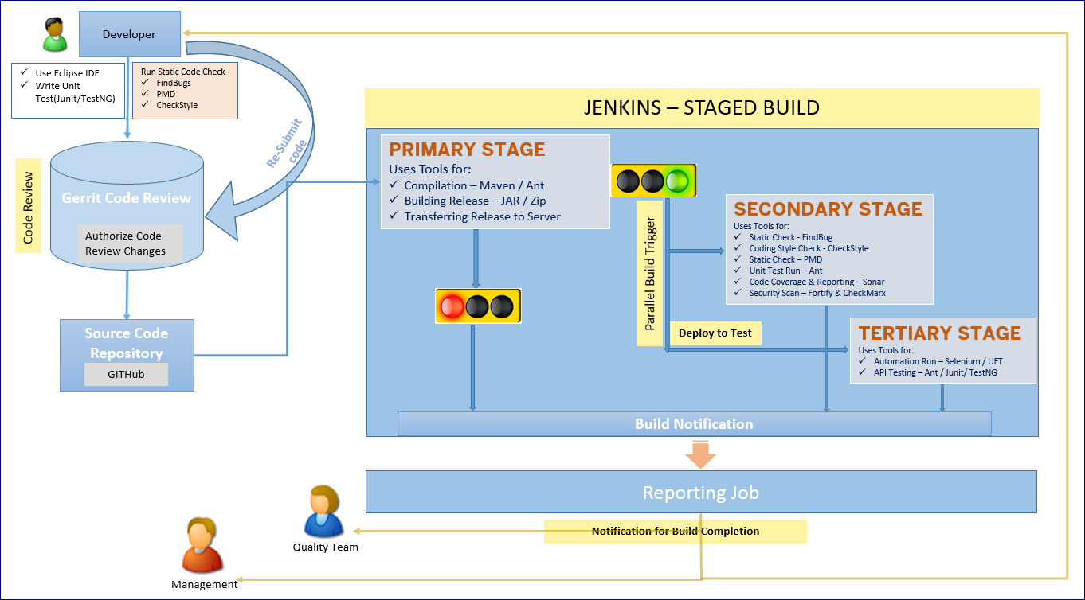
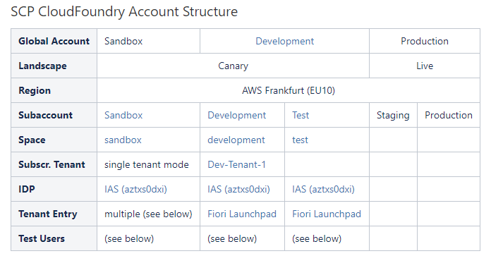
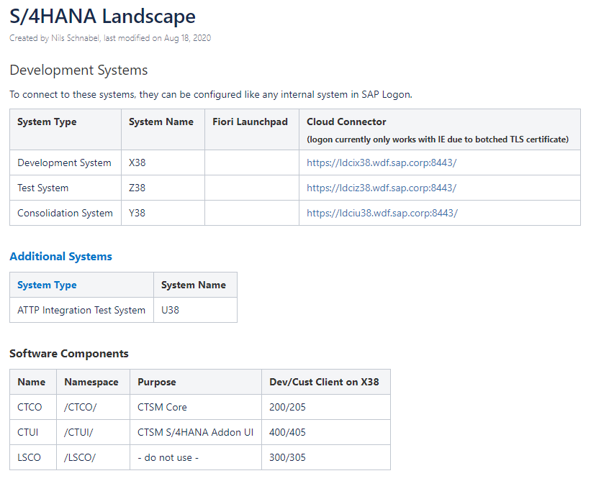
Infrastructure Setup
ABAP Infrastructure Set-up – Dev@SAP/ FBS/ RCS
Non- ABAP Infrastructure Set-up
Run the MACRO to choose the right System Landscape Slide
Cloud Landscapes
S/4 Systems
<ABC/000>
<XYZ/000>
<FGH/000>
System Owner: <Name>
System Owner: <Name>
System Owner: <Name>
Dev
System
Test
System
Consolidation
System
Frequency of transports to be triggered
No Major ATC/CI issues before releasing the TR
Smoke test shows no major functionalities are disrupted due to the import
<….>
CI
Code Review
CI
ABAP Code Scan – Spot Checks
ATC
NOTE: Above is the current Cloud Test tenant setup, on Canary and connected to X38 for the backend.
The Test tenant is planned to be moved to the Live landscape and connected to Z38.
Example

Slide 36
ABAP Infrastructure Set-up – Dev@Cust
ABAP Infrastructure Set-up – Dev@SAP/ FBS/ RCS
Landscape and Infrastructure Setup Cloud & S/4HANA
Run the MACRO to choose the right System Landscape Slide
Canary Landscape
Live Landscape
<XYZ/000>
<XYZ/000>
<FGH/000>
<ABC/000>
<FGH/000>
<ABC/000>
System Owner: <Name>
System Owner: <Name>
System Owner: <Name>
System Owner: <Name>
System Owner: <Name>
System Owner: <Name>
Sandbox
Tenant
Dev
Tenant
Test
Tenant
Staging Tenant
Production Tenant
Dev
System
Dev
System
Test
System
Test
System
Consolidation
System
Production
System
X38 Dev
System
Z38 Test
System
Y38 Consolidation
System
(TBD) Production
System
Frequency of transports to be triggered
No Major ATC/CI issues before releasing the TR
Smoke test shows no major functionalities are disrupted due to the import
Frequency of transports to be triggered
No Major ATC/CI issues before releasing the TR
Smoke test shows no major functionalities are disrupted due to the import
<….>
<….>
CI
Code Review
CI
Code Review
CI
ABAP Code Scan – Spot Checks
Frequency of transports to be triggered
No Major ATC/CI issues before releasing the TR
Smoke test shows no major functionalities are disrupted due to the import
CI/ ATC
ABAP Code Scan – Spot Checks
ATC
CI
Code Review
CI/ ATC
ABAP Code Scan – Spot Checks
<….>

Slide 37
Test Data Requirements
To increase test execution effectiveness, realistic test data of different complexity/variants defined early in the project phases is critical.
To be described based on the Master Data KDEs, in progress
Test Activity | Type | Description & Purpose | Test activity and test object | Creation | Responsible | Available by
<Test data name> | <Master Data, Performance, Transactional Data, Variant> | <test data description, functional/ non-functional tests > | < Test phase/activity. Data used in test cases, requirements, scenario/process, users stories, etc.> | <manual, automated (reports, scripts)> | <Developer, Architect, Tester, Customer> | <date>
Example: Employee information | Master Data | Employee ID, Fname/Lname, address, Dept, passport Functional test | Sprint tests (also reused in Integration test) User stories B2093, B2348, B2347 | Report | Customer (John Doe) | End of Sprint 2
Example: MC Employee information | Master Data (Variant) | Employee ID, Fname/Lname, address, DeptA, passport Multiple-citizenships (passports information, need to be linked with “Taxation” object.) Functional test | Integration test (User stories grouped under “MC & Taxation”) Complex scenario “Multiple-citizenships” | Report | Customer (John Doe) | End of Sprint 3

Slide 38
Test Reporting
Test coverage, bug management, reporting dashboards, traceability

Slide 39
Test Reporting
Needs to be updated and planned for Jira Dashboards
<Report on Test Management helps the stakeholders to evaluate the quality status of solution under development and take corrective actions if required>
Phase | Reporting Parameter | Description
Internal Integration Test | Test Trend Report | Daily Planned Versus actual Test Progress Report
 | Message status Report | Daily Status Wise, Priority Wise Issue Report
https://wiki.wdf.sap.corp/wiki/display/cdlibrary/Reporting

Slide 40
Requirement Traceability Matrix
Purpose of the requirement traceability matrix is to ensure the traceability between requirements and test cases (and vise versa). All the testable requirements shall be tested. The RTM to be documented based on the test management tool used in the project.
Procedure | For projects with JIRA and Zephyr, use Requirement Traceability in Zephyr to generate the traceability report. Out traceability report will be organized by Release Version (CAE Wave 1, CAE Wave 2, IDP Wave 2). All Stories should be linked to at least one test case.

Slide 41
Reference
To be removed incase if the Test Strategy has to be shared with the Customer

Slide 42
Tools Reference
For More Detailed List
To be defined by project team
Category of Tools | Tools for Non-ABAP | ABAP
Source Code Repository with Version Management | GIT, SVN, Clearcase, ABAP | ABAP Workbench
Code / Release building | Maven, Ant | ABAP Workbench
Continuous Integration | Jenkins, Bamboo | ABAP Workbench
Static Code Check | FindBugs, SourceMonitor, PMD, ESLint, JSLint | Code Inspector
Security Code Check | Fortify, CheckMarx | ATC
Coding Style | CheckStyle | NA
Integrated Development Environment | Eclipse, NetBeans | ABAP inbuilt Editor, Eclipse
API Documentation | JavaDoc | ABAP Documentation
Unit Test | Junit, TestNG, QUnit, Clover, Easymock | ABAP Unit
Code Review Tools | Fisheye Crucible, JIRA, Gerrit | Excel, Code Collaborator
Reporting & Coverage Measurement Tools | SonarQube (previously Sonar) | SCOV
Automation Test Tools | Selenium WebDriver, UFT | eCATT, UFT
Performance Test Tools | Jmeter, LoadRunner | STAD, ST05, SAT, ST12, ST03n
Defect Management Tool | JIRA, Bugzilla | CSS
Test Repository Tool | HP QC, Excel | GTP
Documentation Tool | Confluence, Wiki, JAM | Wiki, JAM
Project Management – Scrum / D³ | VersionOne, JIRA | VersionOne, JIRA

Slide 43
Done Criteria
The most current version of the DoD is in the internal Wiki
The Definition of Done (DoD) for all developments are as follows:
Needed for In Review: Coding created, including acceptance criteria met, and coding documented (inline)
Needed for In Review: Critical issues from static check tools solved / required exemptions approved
Needed for In Review: Test case(s) written for SAP internal tests (where applicable)
Needed for In Review: Code tested (developer tests in Dev, undocumented) and critical issues fixed
Needed for In Review: Test automation created (where applicable), automatic unit test passed and no existing unit tests broken
Needed for In Review: Raw documentation in system or dedicated place
Needed for In Review: Go through Code Review checklist
Needed for Completed: Code Review requirements confirmed by a second person (Architect)
Needed for Completed: Code merged into main branch and deployed to test system
The criteria labeled "Needed for In Review" are to be done by the developers. The criteria labeled "Needed for Completed" are to be done by the reviewer (Architect)

Slide 44
Done Criteria for Backlog Items (during Sprints) For more details – refer wiki
D3 done criteria for reference – slide can be removed/changed
Mandatory criteria
Coding created
Coding documented (inline)
Coding checked in (where applicable)
Code review performed
Developer Test performed
(Critical) defects removed
Static code checks without (critical) errors
Recommended criteria
Test cases created
Requirements traceability ensured
Compliance with Product Standards ensured
Security checks without (critical) errors
Performance checks passed
Input for Information developers provided
Regression test performed
Sprint integration tests passed
Automatic unit test performed
Transport into test/consolidation system performed

